Slide 1
Introduction to Software Testing
Chapter 7.2
Engineering Criteria for Technologies
Paul Ammann & Jeff Offutt
http://www.cs.gmu.edu/~offutt/softwaretest/

Slide 2
The Technologies
Chapters 1-5 emphasize criteria on four models of software
Emphasis in each chapter was first on the criteria, then on how to construct the models from different software artifacts
This chapter discusses how to apply the criteria to specific technologies
  Most of the ideas in this chapter were developed after the year 2000
  Thus they are still evolving
Introduction to Software Testing (Ch 7.2)
© Ammann and Offutt

Slide 3
Chapter 7 Outline
Object-Oriented Software
Web Applications and Web Services
Graphical User Interfaces
Real-Time and Embedded Software
Web Applications and Web Services
Introduction to Software Testing (Ch 7.2)
© Ammann and Offutt

Slide 4
Section 7.2 Outline
Most of these ideas were developed after 2000
Few are widely used
Most adapt graph-based testing from Chapter 2
Overview
Overview
Static Hyper Text Web Sites
Dynamic Web Applications
  Client-side testing
  Server-side testing
Web Services
Introduction to Software Testing (Ch 7.2)
© Ammann and Offutt

Slide 5
Issues in Testing Web Software
A web application is a program that is deployed on the web
  Usually uses HTML as the user interface
  Web-deployment means they are available worldwide
  They accept requests through HTTP and return responses
  HTTP is stateless – each request/response pair is independent
Web applications are usually very competitive
A web service is a web-deployed program that accepts XML messages wrapped in SOAP
  Usually no UI with humans
  Service must be published so other services and applications can discover them
Introduction to Software Testing (Ch 7.2)
© Ammann and Offutt

Slide 6
Web Software
Composed of independent, loosely coupled software components
  All communication is through messages
  Web application messages always go through clients
  The only shared memory is through the session object – which is very restricted
  The definition of state is quite different
Inherently concurrent and often distributed
Most components are relatively small
Uses numerous new technologies, often mixed together
Introduction to Software Testing (Ch 7.2)
© Ammann and Offutt

Slide 7
Deploying Software
Bundled : Pre-installed on computer
Shrink-wrap : Bought and installed by end-users
Contract : Purchaser pays developer to develop and install, usually for a fixed price
Embedded : Installed on a hardware device, usually with no direct communication with user
Web : Executed across the Internet through HTTP
Introduction to Software Testing (Ch 7.2)
© Ammann and Offutt

Slide 8
General Problem
Web applications are heterogeneous, dynamic and must satisfy very high quality attributes
Use of the Web is hindered by low quality Web sites and applications
Web applications need to be built better and tested more
Introduction to Software Testing (Ch 7.2)
© Ammann and Offutt

Slide 9
Problem Parameters
HTTP is a stateless protocol
  Each request is independent of previous request
Servers have little information about where a request comes from
Web site software is extremely loosely coupled
  Coupled through the Internet – separated by space
  Coupled to diverse hardware devices
  Written in diverse software languages
Introduction to Software Testing (Ch 7.2)
© Ammann and Offutt

Slide 10
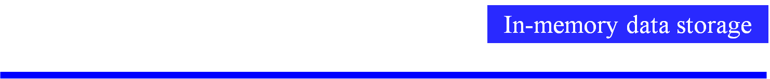

Separation of Concerns in Web Apps
Presentation layer
Data content layer
Data representation layer
Data storage layer
Introduction to Software Testing (Ch 7.2)
© Ammann and Offutt

Slide 11
Differences in Testing Web Software
Traditional graphs do not apply
  Control flow graph
  Call graph
State behavior is hard to model and describe
All inputs go through the HTML UI – low controllability
Hard to get access to server-side state (memory, files, database) – low observability
Not clear what logic predicates can be effectively used
No model for mutation operators on web software
Introduction to Software Testing (Ch 7.2)
© Ammann and Offutt

Slide 12
New Essential Problems of Web Apps
Web site applications feature distributed integration and are extremely loosely coupled
  Internet and diverse hardware / software
HTML forms are created dynamically by web applications
  UI created on demand and can vary by user and time
Users can change the flow of control arbitrarily
  back button, forward button, URL rewriting, refresh
Dynamic integration of new software components
  new components can be added during execution
Introduction to Software Testing (Ch 7.2)
© Ammann and Offutt

Slide 13
Problem 1: Loosely Coupled
server
server
server
client
server
Traditional software
Connected by calls and message passing
High and moderate coupling
Web-based software
Connected with HTTP and XML
Loose, extremely loose, distributed coupling
How can we ensure the reliability of this type of software?
Introduction to Software Testing (Ch 7.2)
© Ammann and Offutt

Slide 14
Extremely Loose Coupling
Tight Coupling : Dependencies among the methods are encoded in their logic
  Changes in A may require changing logic in B
Loose Coupling : Dependencies among the methods are encoded in the structure and data flows
  Changes in A may require changing data uses in B
Extremely Loose Coupling (ELC) : Dependencies are encoded only in the data contents
  Changes in A only affects the contents of B’s data
Introduction to Software Testing (Ch 7.2)
© Ammann and Offutt

Slide 15
Problem 2: Dynamic Flow of Control
WebPics
How you’ns doin’ Jeff Offutt!
WebPics
Huan ying guang ling, Li Nan!
Search
Search
Recommended Movies
Recommended Movies
X
XX
XXX
A
B
C
D
Examine queue
(Warning: Queue empty)
Examine queue
View account
View account
Frequent customer bonus
How can we ensure the reliability of this type of system?
Introduction to Software Testing (Ch 7.2)
© Ammann and Offutt

Slide 16
Dynamic Execution of Web Apps
Parts of the program are generated dynamically
Dynamic web pages are created when users make requests
Different users will see different programs !
The potential control, ala the traditional control flow graph, cannot be known ahead of time
The potential flow of control cannot be known statically
Introduction to Software Testing (Ch 7.2)
© Ammann and Offutt

Slide 17
Problem 3: User Control Flow
Users can make unexpected changes to the flow of control
  Operational transitions are NOT based on an HTML link or program statement
  Back button, forward button, refreshing, caching, URL rewriting
Web software platforms offer new control flow mechanisms
  Forward, redirect, asynchronous message passing (Ajax)
State is stored in the server and in the HTML in the client’s browser
These transitions can cause unanticipated changes to the state of the web application
How can we ensure the reliability of this type of software?
Introduction to Software Testing (Ch 7.2)
© Ammann and Offutt

Slide 18
Problem 4: Dynamic Integration
Software modules can dynamically integrate with others if they use the same data structures
EJBs can be inserted into web applications, which can immediately start using them
Web services find and bind to other web services dynamically
Introduction to Software Testing (Ch 7.2)
© Ammann and Offutt

Slide 19
Section 7.2 Outline
Overview
Static Hyper Text Web Sites
Dynamic Web Applications
  Client-side testing
  Server-side testing
Testing Web Services
Static Hyper Text Web Sites
Introduction to Software Testing (Ch 7.2)
© Ammann and Offutt

Slide 20
Testing Static Hyper Text Web Sites
This is not program testing, but checking that all the HTML connections are valid
The main issue to test for is dead links
We should also evaluate
  Load testing
  Performance evaluation
  Access control issues
The usual model is that of a graph
  Nodes are web pages
  Edges are HTML links
Introduction to Software Testing (Ch 7.2)
© Ammann and Offutt

Slide 21
Section 7.2 Outline
Overview
Static Hyper Text Web Sites
Dynamic Web Applications
  Client-side testing
  Server-side testing
Testing Web Services
Dynamic Web Applications
Introduction to Software Testing (Ch 7.2)
© Ammann and Offutt

Slide 22
Testing Dynamic Hyper Text Web Sites
The user interface is on the client
Some software is on the client (scripts such as Javascript)
Most software is on the server
Client-side testing does not access source or state on the server
Server-side testing can use the source or the server state
Introduction to Software Testing (Ch 7.2)
© Ammann and Offutt

Slide 23
Section 7.2 Outline
Overview
Testing Static Hyper Text Web Sites
Testing Dynamic Web Applications
  Client-side testing
  Server-side testing
Testing Web Services
Client-side testing
Introduction to Software Testing (Ch 7.2)
© Ammann and Offutt

Slide 24
Client-Side (Black-Box) Testing
The UI and the software are on separate computers
The inputs to web software are defined by the HTML form elements
  Text boxes, buttons, dropdown lists, links, etc
Techniques for generating values
  Supplied by the tester
  Generated randomly
  User session data – data collected from previous users of the software
Choosing values
  Bypass testing – values that violate constraints on the inputs, as defined by client-side information
The problem of finding all screens in a web application is undecidable
Introduction to Software Testing (Ch 7.2)
© Ammann and Offutt

Slide 25
Test Value Selection
Challenge
  How to automatically provide effective test values ?
Semantic Domain Problem (SDP)
  Values within the application domain are needed
  Enumeration of all possible test values is inefficient
Possible solutions
  Random values (ineffective)
  Automatically generated values (very hard!)
  User data (incomplete)
  Study application and construct a set of values (feasible)
  Tester-supplied inputs (feasible but expensive)
Introduction to Software Testing (Ch 7.2)
© Ammann and Offutt

Slide 26
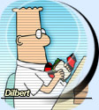

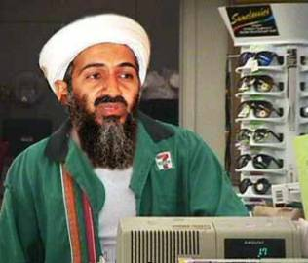


Web Application Input Validation
Bad Data
Corrupts data base
Crashes server
Security violations
Check data
Check data
Sensitive Data
Client
Server
Malicious Data
Can “bypass” data checking
Introduction to Software Testing (Ch 7.2)
© Ammann and Offutt

Slide 27
Bypass Testing
“bypass” client-side constraint enforcement
Bypass testing constructs tests to intentionally violate constraints :
  Eases test automation
  Validates input validation
  Checks robustness
  Evaluates security
Introduction to Software Testing (Ch 7.2)
© Ammann and Offutt

Slide 28
User Name:
Age:
Version to purchase:
Small
$150
Medium
$250
Large
$500
Introduction to Software Testing (Ch 7.2)
© Ammann and Offutt

Slide 29
Invalid data, please correct …
User Name:
Alan<Turing
Age:
500
Username should be plain text only.
Age should be between 18 and 150.
Version to purchase:
Small
$150
Medium
$250
Large
$500
Introduction to Software Testing (Ch 7.2)
© Ammann and Offutt

Slide 30
Abbreviated HTML
<FORM >
<INPUT Type=“text” Name=“username” Size=20>
<INPUT Type=“text” Name=“age” Size=3 Maxlength=3>
<P> Version to purchase:
…
<INPUT Type=“radio” Name=“version” Value=“150” Checked>
<INPUT Type=“radio” Name=“version” Value=“250”>
<INPUT Type=“radio” Name=“version” Value=“500”>
<INPUT Type="submit" onClick="return checkInfo(this.form)">
<INPUT Type=“hidden” isLoggedIn=“no”>
</FORM>
Introduction to Software Testing (Ch 7.2)
© Ammann and Offutt

Slide 31
Bypass Behavior
Extremely loose coupling …
combined with the stateless protocol …
allows users to easily bypass client-side checking :
Users can save and modify the HTML
Introduction to Software Testing (Ch 7.2)
© Ammann and Offutt

Slide 32
Saved & Modified HTML
<FORM >
<INPUT Type=“text” Name=“username” Size=20>
<INPUT Type=“text” Name=“age” Size=3 Maxlength=3>
<P> Version to purchase:
…
<INPUT Type=“radio” Name=“version” Value=“150”>
<INPUT Type=“radio” Name=“version” Value=“250”>
<INPUT Type=“radio” Name=“version” Value=“500” Checked>
<INPUT Type=“submit” onClick=“return checkInfo (this.form)”>
<INPUT Type=“hidden” isLoggedIn= “no” >
</FORM>
Allows an input with arbitrary age, no checking, cost=$25 …
‘<‘ can crash an XML parser
Text fields can have SQL statements
25
yes
Introduction to Software Testing (Ch 7.2)
© Ammann and Offutt

Slide 33
SQL Injection
turing
’ OR ‘1’=‘1
enigma
User Name:
Password:
’ OR ‘1’=‘1
Original SQL:
SELECT username FROM adminuser WHERE username=‘turing’ AND password =‘enigma’
“injected” SQL:
SELECT username FROM adminuser WHERE username=‘turing’ OR ‘1’ = ‘1’ AND password =‘enigma’ OR ‘1’ = ‘1’
Introduction to Software Testing (Ch 7.2)
© Ammann and Offutt

Slide 34
Bypass Testing
This example illustrates how users can “bypass” client-side constraint enforcement
Bypass testing constructs tests to intentionally violate constraints
  Eases test automation
  Checks robustness
  Evaluates security
Preliminary results
  Rules for constructing tests
  Successfully found errors in numerous Web apps
Introduction to Software Testing (Ch 7.2)
© Ammann and Offutt

Slide 35
Applying Bypass Testing
Validating input data on the client is like asking your opponent to hold your shield in a sword fight
Analyze HTML to extract each form element
Model constraints imposed by HTML and JavaScript
Rules for data generation :
  From client-side constraints
  Typical security violations
  Common input mistakes
Introduction to Software Testing (Ch 7.2)
© Ammann and Offutt

Slide 36
Types of Client Input Validation
Client side input validation is performed by HTML form controls, their attributes, and client side scripts that access DOM
Validation types are categorized as HTML and scripting
  HTML supports syntactic validation
  Client scripting can perform both syntactic and semantic validation
HTML Constraints | Scripting Constraints
Length (max input characters) Value (preset values) Transfer Mode (GET or POST) Field Element (preset fields) Target URL (links with values) | Data Type (e.g. integer check) Data Format (e.g. ZIP code format) Data Value (e.g. age value range) Inter-Value (e.g. credit # + exp. date) Invalid Characters (e.g. <,../,&)
Introduction to Software Testing (Ch 7.2)
© Ammann and Offutt

Slide 37
Example Client-Side Constraint Rules
Violate size restrictions on strings
Introduce values not included in static choices
  Radio boxes
  Select (drop-down) lists
Violate hard-coded values
Use values that JavaScripts flag as errors
Change “transfer mode” (get, post, …)
Change destination URLs
Introduction to Software Testing (Ch 7.2)
© Ammann and Offutt

Slide 38
Example Server-Side Constraint Rules
Data type conversion
Data format validation
Inter-field constraint validation
Inter-request data fields (cookies, hidden)
Introduction to Software Testing (Ch 7.2)
© Ammann and Offutt

Slide 39
Example Security Violation Rules
Potential Illegal Character | Symbol
Empty String
Commas | ,
Single and double quotes | ’ or ”
Tag symbols | Tag symbols < and >
Directory paths | .. ../
Strings starting with forward slash | /
Strings starting with a period | .
Ampersands | &
Control character | NIL, newline
Characters with high bit set | 254 and 255
Script symbols | <javascript> or <vbscript>
Introduction to Software Testing (Ch 7.2)
© Ammann and Offutt

Slide 40
Test Value Selection
Challenge:
  How to automatically provide effective test values?
Semantic Domain Problem (SDP)
  Values within the application domain are needed
  Enumeration of all possible test values is inefficient
Possible Solutions
  Random Values (ineffective – lots of junk)
  Automatically generated values (very hard)
  Taking values from session log files (feasible but incomplete)
  Tester input (feasible)
Our tool used an input domain created by parsing the interface and tester input
Introduction to Software Testing (Ch 7.2)
© Ammann and Offutt

Slide 41
Real-World Examples
atutor.ca
Atalker
demo.joomla.or
Poll, Users
phpMyAdmin
Main page,
Set Theme,
SQL Query,
DB Stats
brainbench.com
Submit Request Info, New user
myspace.com
Events & Music Search
nytimes.com
Us-markets
mutex.gmu.edu
Login form
yahoo.com
Notepad, Composer,
Search reminder, Weather Search
barnesandnoble.com
Cart manager,
Book search/results
amazon.com
Item dispatch,
Handle buy
bankofamerica.com
ATM locator, Site search
comcast.com
Service availability
ecost.com
Detail submit,
Shopping cart control
google.com
Froogle, Language tools
pageflakes.com
Registration
wellsfargolife.com
Quote search
Pure black-box testing
means
no source (or permission) needed !
Introduction to Software Testing (Ch 7.2)
© Ammann and Offutt

Slide 42
Output Checking
(V) Valid Responses : invalid inputs are adequately processed by the server
(F) Faults & Failures : invalid inputs that cause abnormal server behavior (typically caught by web server when application fails to handle the error)
(E) Exposure : invalid input is not recognized by the server and abnormal software behavior is exposed to the users
These do not capture whether the valid responses corrupted data on the server
(V1) | Server acknowledges the invalid request and provides an explicit message regarding the violation
(V2) | Server produces a generic error message
(V3) | Server apparently ignores the invalid request and produces an appropriate response
(V4) | Server apparently ignores the request completely
Introduction to Software Testing (Ch 7.2)
© Ammann and Offutt

Slide 43
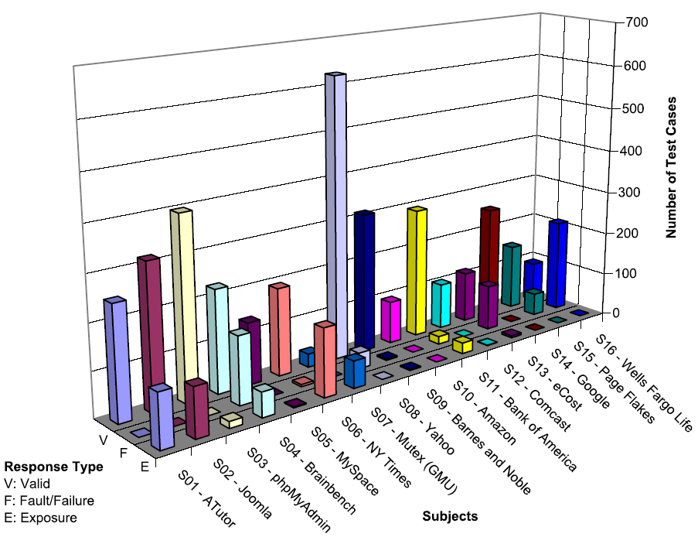
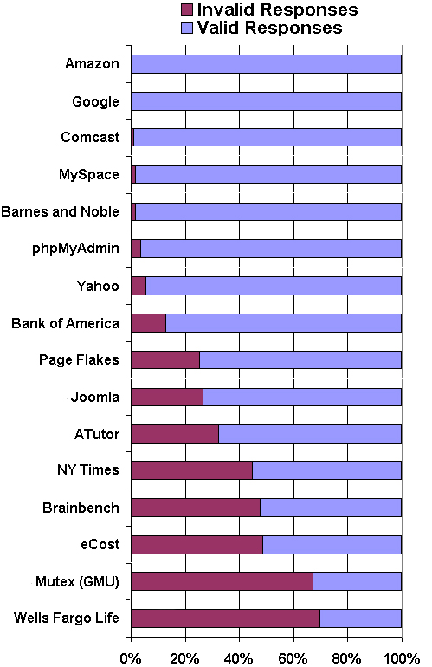
Results
v
Introduction to Software Testing (Ch 7.2)
© Ammann and Offutt

Slide 44
Section 7.2 Outline
Overview
Testing Static Hyper Text Web Sites
Testing Dynamic Web Applications
  Client-side testing
  Server-side testing
Testing Web Services
Server-side testing
Introduction to Software Testing (Ch 7.2)
© Ammann and Offutt

Slide 45
Server-Side (White-Box) Testing
If we have access to the source on the server, we can try to model the web software
Many testing criteria on non-web software rely on a static control flow graph
  Edge testing, data flow, logic coverage, …
  Also slicing, change impact analysis, …
The standard control flow graph cannot be computed for web applications !
But all the pieces of the web pages and the programs are contained in the software presentation layer …
Introduction to Software Testing (Ch 7.2)
© Ammann and Offutt

Slide 46
Atomic Sections :
HTML with static structure and content variables
PrintWriter out = response.getWriter();
P1 =
out.println ("<HTML>")
out.println ("<HEAD><TITLE>" + title + "</TITLE></HEAD>)"
out.println ("<BODY>")
title
if (isUser) {
Atomic
sections
P2 =
out.println (“ <CENTER> Welcome!</CENTER>");
for (int i=0; i<myVector.size(); i++)
if (myVector.elementAt(i).size > 10)
P3 =
out.println (“<p><b>" + myVector.elementAt(i) + "</b></p>");
myVector.elementAt(i)
else
P4 =
out.println (“<p>" + myVector.elementAt(i) + "</p>");
myVector.elementAt(i)
Empty
atomic
section
} else
P5 =
{ }
Content
variables
P6 =
out.println (“</BODY></HTML>");
out.close ();
Introduction to Software Testing (Ch 7.2)
© Ammann and Offutt

Slide 47
Atomic Sections
A section of HTML with the property that if any part of the section is sent to a client, the entire section is
  May include JavaScript
  All or nothing property
An HTML file is an atomic section
Content variable : A program variable that provides data to an atomic section
Atomic sections may be empty
Introduction to Software Testing (Ch 7.2)
© Ammann and Offutt

Slide 48
Modeling Web Applications
Restricted to the presentation layer only
Two levels of abstraction
  Component Interaction Model (CIM)
    Models individual components
    Combines atomic sections
    Intra-component
  Application Transition Graph (ATG)
    Each node is one CIM
    Edges are transitions among CIMs
    Inter-component
Introduction to Software Testing (Ch 7.2)
© Ammann and Offutt

Slide 49
Component Expressions
Atomic sections are combined to model dynamically generated web pages
Four ways to combine:
  Sequence : p1 • p2
  Selection : (p1 | p2)
  Iteration : p1*
  Aggregation : p1 {p2}
    p2 is included inside of p1
The previous example produces:
  p → p1 • (p2 • (p3 | p4)* | p5) • p6
Composite sections can be produced automatically
Introduction to Software Testing (Ch 7.2)
© Ammann and Offutt

Slide 50
Modeling Component Transitions
Five types of transitions
  Simple Link Transition : An HTML link (<A> tag)
  Form Link Transition : Form submission link
  Component Expression Transition : Execution of a software component causes a component expression to be sent to the client
  Operational Transition : A transition out of the software’s control
    Back button, Forward button, Refresh button, User edits the URL, Browser reloads from cache
  Redirect Transition : Server side transition, invisible to user
Introduction to Software Testing (Ch 7.2)
© Ammann and Offutt

Slide 51
Component Interaction Model : gradeServlet
ID = request.getParameter ("Id");
passWord = request.getParameter ("Password");
retry = request.getParameter ("Retry");
PrintWriter out = response.getWriter();
P1 =
out.println (“<HTML> <HEAD><TITLE>" + title + "</TITLE></HEAD><BODY>)"
if ((Validate (ID, passWord)) {
P2 =
out.println (“ <B> Grade Report </B>");
for (int I=0; I < numberOfCourse; I++)
P3 =
out.println(“<p><b>" + courseName (I) + "</b>“ + courseGrade (I) + “</p>”);
} else if (retry < 3) {
P4 =
retry++;
out.println ("Wrong ID or wrong password");
out.println ("<FORM Method=\“get\" Action=\"gradeServlet\">);
out.println ("<INPUT Type=\“text\" Name=\"Id\" Size=10>");
out.println ("<INPUT Type=\“password\" Name=\"Password\" Width=20>");
out.println ("<INPUT Type=\“hidden\" Name=\"Retry\" Value=" + (retry) + ">");
out.println ("<INPUT Type=\“submit\" Name=\“Submit\" Value=\“submit\">");
out.println ("<A Href=\"sendMail\">Send mail to the professor</A>");
} else if (retry >= 3) {
P5 =
out.println (“<p>Wrong ID or password, retry limit reached. Good bye.") }
P6 =
out.println(“</BODY></HTML>");
Introduction to Software Testing (Ch 7.2)
© Ammann and Offutt

Slide 52
CIM for gradeServlet
S = login.html
A = {p₁, p₂, p₃, p₄, p₅, p₆ }
CE = gradeServlet = p₁ • ((p₂ • p₃* ) | p₄ | p₅) • p₆
T = {login.html gradeServlet [get, (Id, Password, Retry)],
gradeServlet.p₄ sendMail [get, ()],
gradeServlet.p₄ gradeServlet [get, (Retry)] }
Introduction to Software Testing (Ch 7.2)
© Ammann and Offutt

Slide 53
Application Transition Graph
Γ : Finite set of web components
Θ : Set of transitions among web software components
  Includes type of HTTP request and data
Σ : Set of variables that define the web application state
α : Set of start pages
Introduction to Software Testing (Ch 7.2)
© Ammann and Offutt

Slide 54
ATG for gradeServlet
Γ = { login.html, gradeServlet, sendMail, syllabus.html }
Θ = {login.html syllabus.html [get, ()],
login.html gradeServlet [get, (Id, Password, Retry)],
gradeServlet.p₄ sendMail [get, ()],
gradeServlet.p₄ gradeServlet [get, (Retry)] }
Σ = { Id, Password, Retry }
α = { login.html }
Introduction to Software Testing (Ch 7.2)
© Ammann and Offutt

Slide 55
ATG for gradeServlet
get ()
login.html
get ()
syllabus.html
get
(Id, Password, Retry)
get (Id, Password, Retry)
gradeServlet
p1
p2
p4
p5
get ()
sendMail
p3
p6
Introduction to Software Testing (Ch 7.2)
© Ammann and Offutt

Slide 56
Atomic Section Modeling
Atomic sections provide a fundamental mechanism to model Web applications presentation layer
Can handle :
  Distributed integration
  Dynamically created HTML pages
  Operational transitions
Requires deep analysis of software source
Introduction to Software Testing (Ch 7.2)
© Ammann and Offutt

Slide 57
Some Current Open Questions
How to define data flow?
  DU-pairs cannot be determined statically – uses cannot always be found
Automatically generating ATG
Issues not handled:
  Session data
  Multiple users
  Concurrency
  Input data
  Output validation
  Dynamic integration
Introduction to Software Testing (Ch 7.2)
© Ammann and Offutt

Slide 58
Section 7.2 Outline
Overview
Static Hyper Text Web Sites
Dynamic Web Applications
  Client-side testing
  Server-side testing
Testing Web Services
Testing Web Services
Introduction to Software Testing (Ch 7.2)
© Ammann and Offutt

Slide 59
Web Services
A Web Service is a program that offers services over the Internet to other software programs
  Internet-based
  Uses SOAP and XML
  Peer-to-peer communication
Web service components can integrate dynamically, by finding other services during execution
Web services transmit data that are formatted in XML
Introduction to Software Testing (Ch 7.2)
© Ammann and Offutt

Slide 60
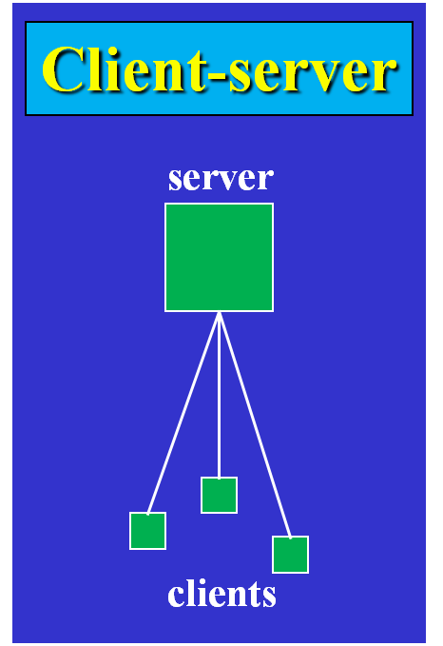
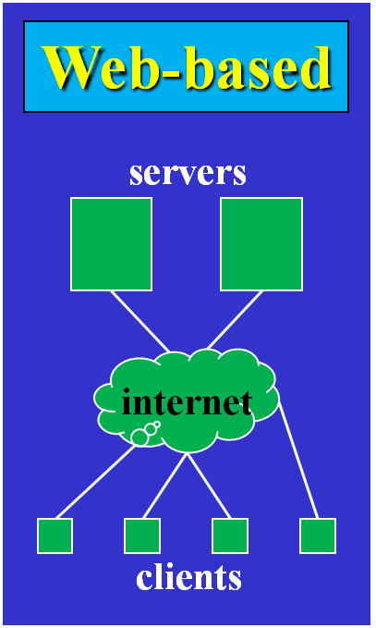
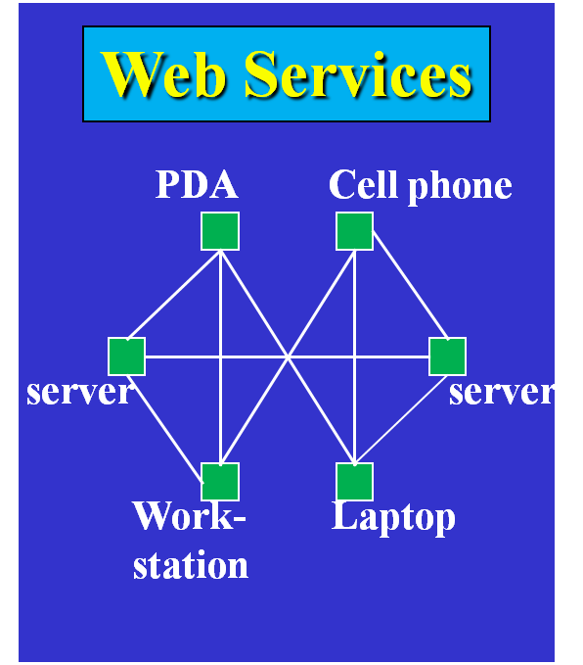
Web Service Architecture
Introduction to Software Testing (Ch 7.2)
© Ammann and Offutt

Slide 61
Web Service Technologies
Find
UDDI Registry
WSDL Specification
Applications
SOAP / XML
Points to URL
SOAP / XML
Specification
Specification
Bind
Publish
Wrapped
Wrapped
Legacy System
Components
Services
Introduction to Software Testing (Ch 7.2)
© Ammann and Offutt

Slide 62
Difficulties of Testing Web Services
Web services are always distributed
Most “peer-to-peer” communication is between services published by different organizations
  Trust is a major issue holding back the adoption of web services !
Design and implementation are almost never available
Structured messages are transmitted
Most testing research so far has focused on messages
  Syntax-based test criteria have been proposed for Web services
Introduction to Software Testing (Ch 7.2)
© Ammann and Offutt

Slide 63
Conclusions
The Web provides a new way to deploy software
Web applications:
  offer many advantages
  use many new technologies
  introduce fascinating new problems
Web Software Engineering is just beginning
Two very useful techniques:
  Bypass testing : Easy to automate – no source needed
  Atomic sections : A fundamental model
This is a very active research area
Introduction to Software Testing (Ch 7.2)
© Ammann and Offutt

